Slide 1
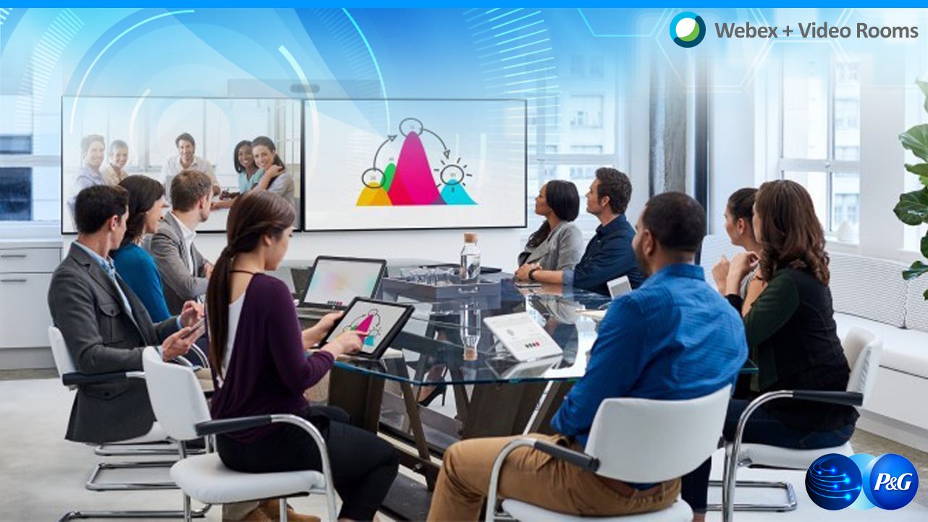

Webex + Video Rooms
New Capabilities: Scheduling/Meeting Start Changes

Slide 2
Agenda
What's Changing
What Meeting Hosts Need to Do
Tips
Q&A

Slide 3
What’s Changing
Doubling Number of Video Rooms (From 280 to 584 rooms)
FY 18/19: Refreshing 160 existing end-of-life Video Rooms with new technology
FY 19/20: Installing new incremental Video Rooms (mostly huddle rooms)
Video Room & Webex participants can now see each other!
Current Video Room experience when using Webex​:
All participants can hear each other and see shared desktop/applications
Webex & Video Room participants can’t see each other.
​New Video Room experience when using the integrated version of Webex & Video Rooms​:
Video Room and Webex participants can see each other!
Notes:
New technology to be used in the refreshes - Speaker Track Rooms

Slide 4
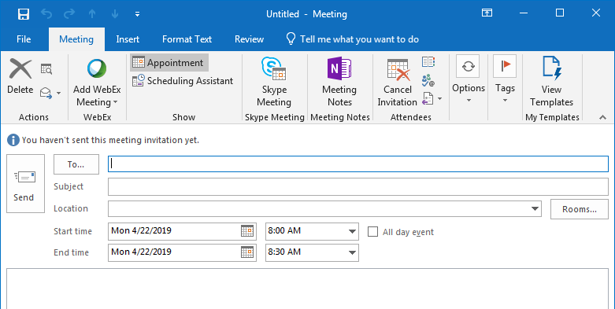
What Video Room Meeting Hosts need to do​
1. Change how you Schedule a Meeting
New! Add a Webex Meeting to ALL meetings taking place in a Video Room. Even if you don't expect to have remote participants!
To Schedule a meeting:
In Outlook, create a new meeting invitation.
Click Add Webex Meeting.

Slide 5
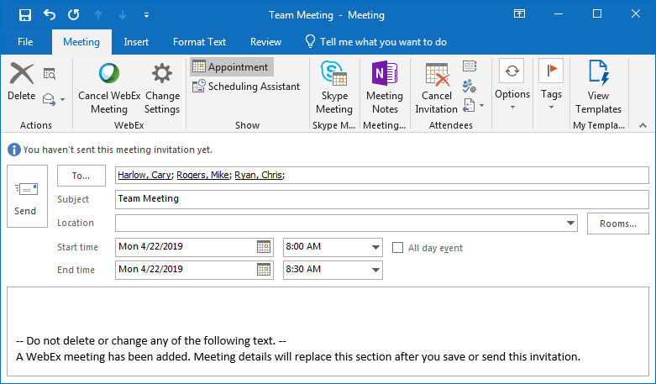
What Video Room Meeting Hosts need to do​
1. Change how you Schedule a Meeting
Add attendees to the meeting invitation.

Slide 6
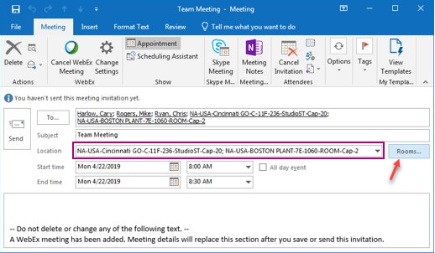
What Video Room Meeting Hosts need to do​
1. Change how you Schedule a Meeting
Add Video Rooms to the meeting invitation.

Slide 7
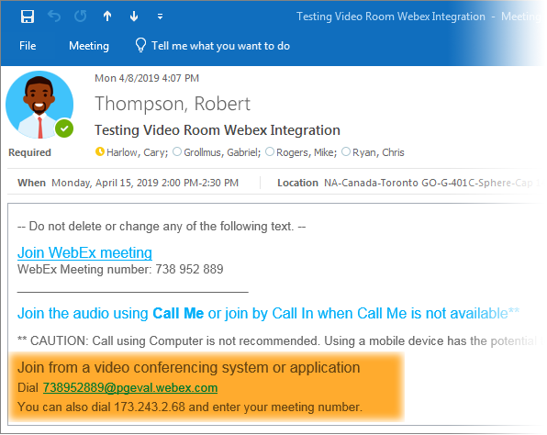
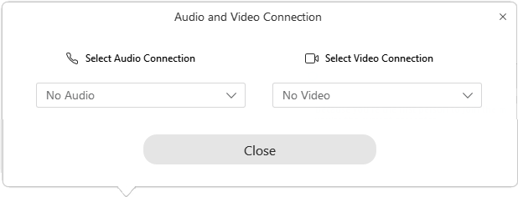
What Video Room Meeting Hosts need to do:
2. Change how you start a Meeting in the Video Room
If your meeting invitation includes the text Join from a video system or application:
The meeting Host should join the Webex meeting from their computer even if in the Video Room and should select No Audio from the Webex connection popup.

Slide 8

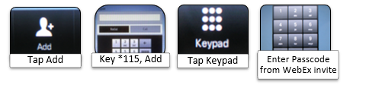
What Video Room Meeting Hosts need to do:
2. Change how you start a Meeting in the Video Room
If the meeting invitation includes the ‘Join from a video system or application’ text
Participants in each video room should click the Join button on Video Room panel.
Do NOT add Webex audio. The room will provide the audio for the meeting.

Slide 9
What Video Room Meeting Hosts need to do:
2. Change how you start a Meeting in the Video Room
If the meeting invitation does NOT include the ‘Join from a video system or application’ text:
Participants in each video room should click the Join button on Video Room panel.
One video room should add Webex audio using the steps shown below.
Note: Refer to the in-room meeting guide when in the room.

Slide 10
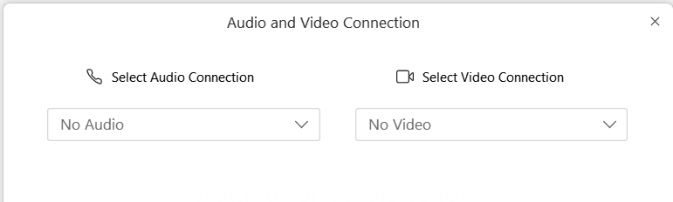
What Video Room Meeting Hosts need to do:
Important – How to avoid screeching audio feedback
Webex is automatically connected to the video room in meetings that include the Join from a video system or application text as part of the invite.
Do NOT add Webex Audio to the meetings using the Dial *115 steps. Doing so will add the Webex into the meeting twice and will result in screeching audio feedback.
Do NOT add Webex Audio when connecting to Webex from your PC when located in the Video Room.
Select No Audio and No Video when joining Webex from PCs in a video room.

Slide 11
Tips
Video Rooms
If prompted to enter a host key when joining a meeting from a room, enter # to indicate the room is joining as a participant. This prompt is only heard if the host has not already joined via Webex from his/her laptop.
Make sure a Webex meeting host will be participating in the meeting. For more info:
See link to assigning alternate meeting host
See link to info on how to schedule Webex meetings for others
Meeting host should use Webex on PC to manage the meeting even if the host is in a video room
Host can mute/un-mute both rooms and individual participants from the room
There are two options for sharing your desktop/application from video rooms:
Plug the cable into the laptop from the room, or
Join Webex from the PC and share from Webex
Can select different layouts from video rooms.
Use numbers 2 and 8 on the keypad to cycle through layouts.

Slide 12
Tips
Video Rooms
Quality of video resolution
Video Rooms should be good 720p
Video for Webex users as seen in the video rooms is dependent on the Webex participant’s network connection
Video that Webex users see of the video room is capped at 360p due to network concerns. We hope to make a change in the future to increase this to 720p

Slide 13
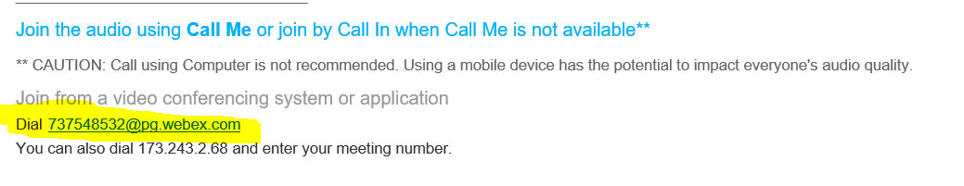
Expected Questions/Issues
Q1: Why Can’t my Webex users see me or Why can’t I see the video room?
Likely causes:
Meeting was scheduled before the new Webex feature was enabled. If they want to resolve immediately, the meeting host can send a new Webex meeting invite to all participants, and then each video room can join by opening the dial pad on the room panel and dialing the number in the invite which appears similar to highlighted area:
Meeting host added Webex link to the invite less than 20 minutes before start of the meeting. Solution is to have the room call into the webex by dialing meeting string highlighted above.
Other possibilities:
Webex participants don’t have webcam turned on
Network not sufficient to support video to/from Webex participants
Webex participant has numerous applications open consuming CPU

Slide 14
Expected Questions/Issues
Q2: I joined a video room meeting but my room and Webex participants can’t hear each other.
Likely cause: Meeting host added Webex link less than 20 minutes before the start of the video meeting OR meeting host copied/pasted Webex link into the invite instead of adding Webex to invite
Solution: Have each video room dial to Webex to join the meeting as explained in previous question.
Another possibility: Webex meeting host muted room (either separately or by activating “Mute All”) or individual rooms or participants muted each other.
Solution: Webex meeting host to find room in participant list and un-mute or have rooms/participants un-mute themselves. (Note: When webex host mutes a room, the red mute button on the room is not activated.)
Q3: How do I turn video room volume up/down?
Volume controls for the new rooms are on the frame for the video room touch panel (easy to miss!)

Slide 15
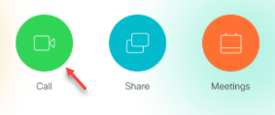

Expected Questions/Issues
Q4: How can I join the meeting if there’s no green join button on my room panel?
A: Dial into Webex using the video conferencing room panel and dial string highlighted in yellow
FYI--Known issue: If meeting host includes an image in the Webex invite, the green Join button doesn’t get posted in the video rooms.
Q5: The audio quality for one of my Webex participants is breaking up. (Frequent Webex question; not unique to this new capability.)
Make sure the Webex participant is not using “Call my Computer” and/or have them try calling back to a different phone number.

Slide 16
Expected Questions/Issues
Q6: There’s audio feedback (screeching audio) on the line!
Likely cause: Participants in one or more of the video rooms joined the meeting using the green join button AND dialed *115 to add Webex which thereby added Webex audio to the same meeting twice.
Solution: Meeting host mute rooms; Have Video Rooms disconnect Webex audio
Other possibility: One of the participants in the video room also joined Webex audio from their PC
Solution: Meeting host mute all lines; have user who joined audio from PC in the room, disconnect audio
.

Slide 17
Expected Questions/Issues
Q7: There’s noise on the line, e.g. typing, rustling papers, barking dog, etc.
Solution: Have Webex meeting host watch for speaking indicator next to participants and mute noisy line
Note: If the meeting host is not in the room, can contact Cisco Webex help desk to ask them to assist in resolving but it will take time. For future meetings, advise meeting leader to have host always designate an “Alternate Host” if they are not able to attend so that there is always someone with host capabilities in the meeting.
Q8: Meeting ends abruptly
Likely cause: Meeting host had to leave the meeting early and clicked “End Meeting” instead of “Leave Meeting”
Solution: Have someone send out a new invite; have video rooms dial in using the instructions in the invite
Q9: Does anything change with Blue Jeans?
No, continue as usual

Slide 18
Employee Communications
Employees are receiving a range of communications:
eMails to all Webex meeting hosts advising them of the change – includes link to documentation and a training video
Focused emails to employees who have booked video rooms in the past 12 months explaining how to update video conference meeting invitations.
Optional to update meetings before Oct 1
Required to update meetings after Oct 1
Digital displays being updated with our “Better Together” campaign
Video Room displays updated with Alert indicating meeting join process changed
Quick Reference Guides in video rooms updated with changes to Webex join process
Training on how to update meetings and a Webex refresher will be provided; schedule will be posted here soon

Slide 19
QUESTIONS
Click here for FAQs
Contact Cisco for Video Room Support – Includes phone and email options
Contact Cisco for Webex Support – Includes phone and chat options
Note: If issue occurring in a video room, start with Cisco Video support. Cisco will coordinate behind the scenes if both Video and Webex support help needed.
Notes:
VCNG Regional PMs: Joanne Whitlie – Europe, Carmela Corpuz – Asia, Ana Pozos – LA, Jason Harmon – NA, Mai Shrief – IMEA, Tom Hylton - Global

